Slide 1
NTE 1010
Introduction to Finance for Engineers
Spring 2020
week
8
Financial Crises

Slide 2
NTE 1010 – Introduction to Finance for Engineers
Stock Markets
Huge Swings in the Stock Market in Recent Years
The 1990s were an extraordinary decade for stocks:
The Dow Jones and S&P500 indexes increased more than 400%,
while the tech-laden NASDAQ index rose more than 1,000%.
By early 2000, all indexes had reached record highs.
Unfortunately, the good times did not last.
Starting in early 2000, the stock market began to decline and many investors lost their shirts.
The NASDAQ crashed, falling by more than 50%,
while the Dow Jones and S&P500 indexes fell by 30% through January 2003.
After subseuently rising over 30%,
the stock market crashed again during the global financial crisis,
falling over 50% from its peak in the fall of 2007.
Starting in 2009, the stock market recovered quickly, rising by more than 50% by 2011.

Slide 3
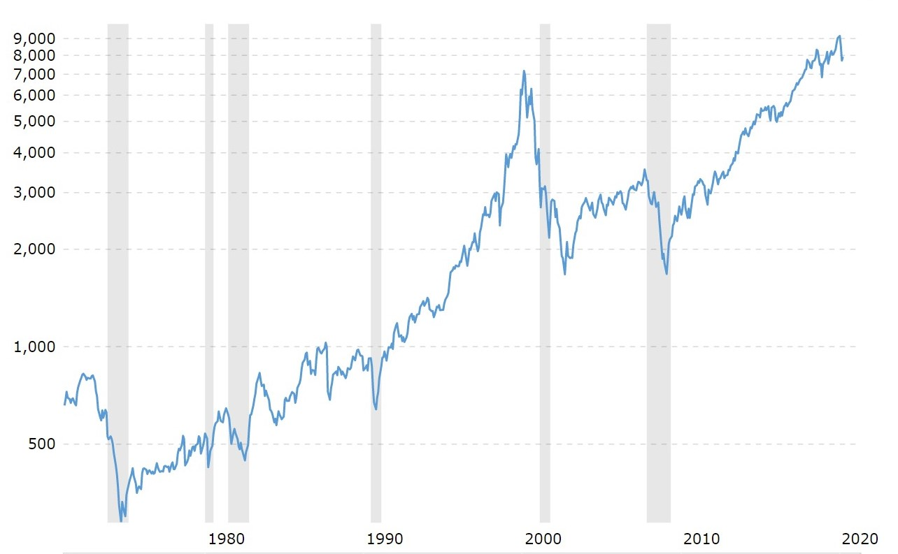
NTE 1010 – Introduction to Finance for Engineers
Stock Markets
Dow Jones Industrial Average Stock Market Index
Inflation-adjusted, gray bands: recession periods

Slide 4
NTE 1010 – Introduction to Finance for Engineers
Stock Markets
Recession of 1990-1991
The recession lasted from July 1990 to March 1991.
From November 1982 to July 1990 the U.S. economy experienced
robust growth, modest unemployment, and low inflation.
The "Reagan boom" rested on shaky foundations, however,
and as the 1980s progressed signs of trouble began to mount.
On October 19, 1987 stock markets around the world crashed (started in the Far East).
In the U.S. the Dow Jones Industrial Average lost over 22% of its value.
Although the causes of "Black Monday" were complex, many saw the crash as a sign that
investors were worried about the inflation that might result from large U.S. budget deficits.
The American housing market presented another sign of weakness,
as in the second half of the 1980s a large number of savings and loan associations (private banks that specialized in home mortgages) went bankrupt.
The collapse of the S&L industry negatively impacted the welfare of many American households and precipitated a large government bailout that placed further strain on the budget.
Other causes of the early 1990s recession included
moves by the U.S. Federal Reserve to raise interest rates in the late 1980s
and Iraq's invasion of Kuwait in the summer of 1990 which drove up the world price of oil,
decreased consumer confidence, and exacerbated the downturn that was already underway.

Slide 5
NTE 1010 – Introduction to Finance for Engineers
Stock Markets
Recession of 2001
The 2001 recession resulted from the Y2K scare (i.e. Year 2000).
In 1999, there was an economic boom in computer and software sales
as many companies and individuals bought new computer systems
to make sure their software was Y2K compliant.
As a result, the stock price of many high-tech companies started to increase.
Investors' began buying stock in any high tech company, whether they were showing profits or not.
The exuberance for dot.com companies became irrational. The boom led to a bust in dot-com businesses.
As a result, the stock market dropped in March 2000.
As stock prices declined, so did the value of the dot.com companies and many went bankrupt.
The Federal Reserve ignored the markets and continued raising interest rates.
Interest rates remained high when the economy needed low rates for cheap credit.
In 2001, the 9/11 attack worsened the downturn.
The New York Stock Exchange closed for four trading days after the attacks.
When the stock market reopened, the Dow Jones Industrial Average fell 7 percent in one day.
The Bush administartion helped to end the recession
with expansionary fiscal policy (e.g. tax cuts, and more government spending).

Slide 6
NTE 1010 – Introduction to Finance for Engineers
Stock Markets
Financial Crisis of 2007-2008
It began in 2007 with a crisis in the subprime mortgage market in the United States,
and developed into a full-blown international banking crisis
with the collapse of the investment bank Lehman Brothers on September 15, 2008.
Excessive risk-taking by banks such as Lehman Brothers
helped to magnify the financial impact globally.
Massive bail-outs of financial institutions
and other palliative monetary (″quantitative easing″)
and fiscal policies
were employed to prevent a possible collapse of the world financial system.
The crisis was nonetheless followed by a global economic downturn, the Great Recession.
The Europen debt crisis,
a crisis in the banking system of the European countries using the euro, followed later.

Slide 7
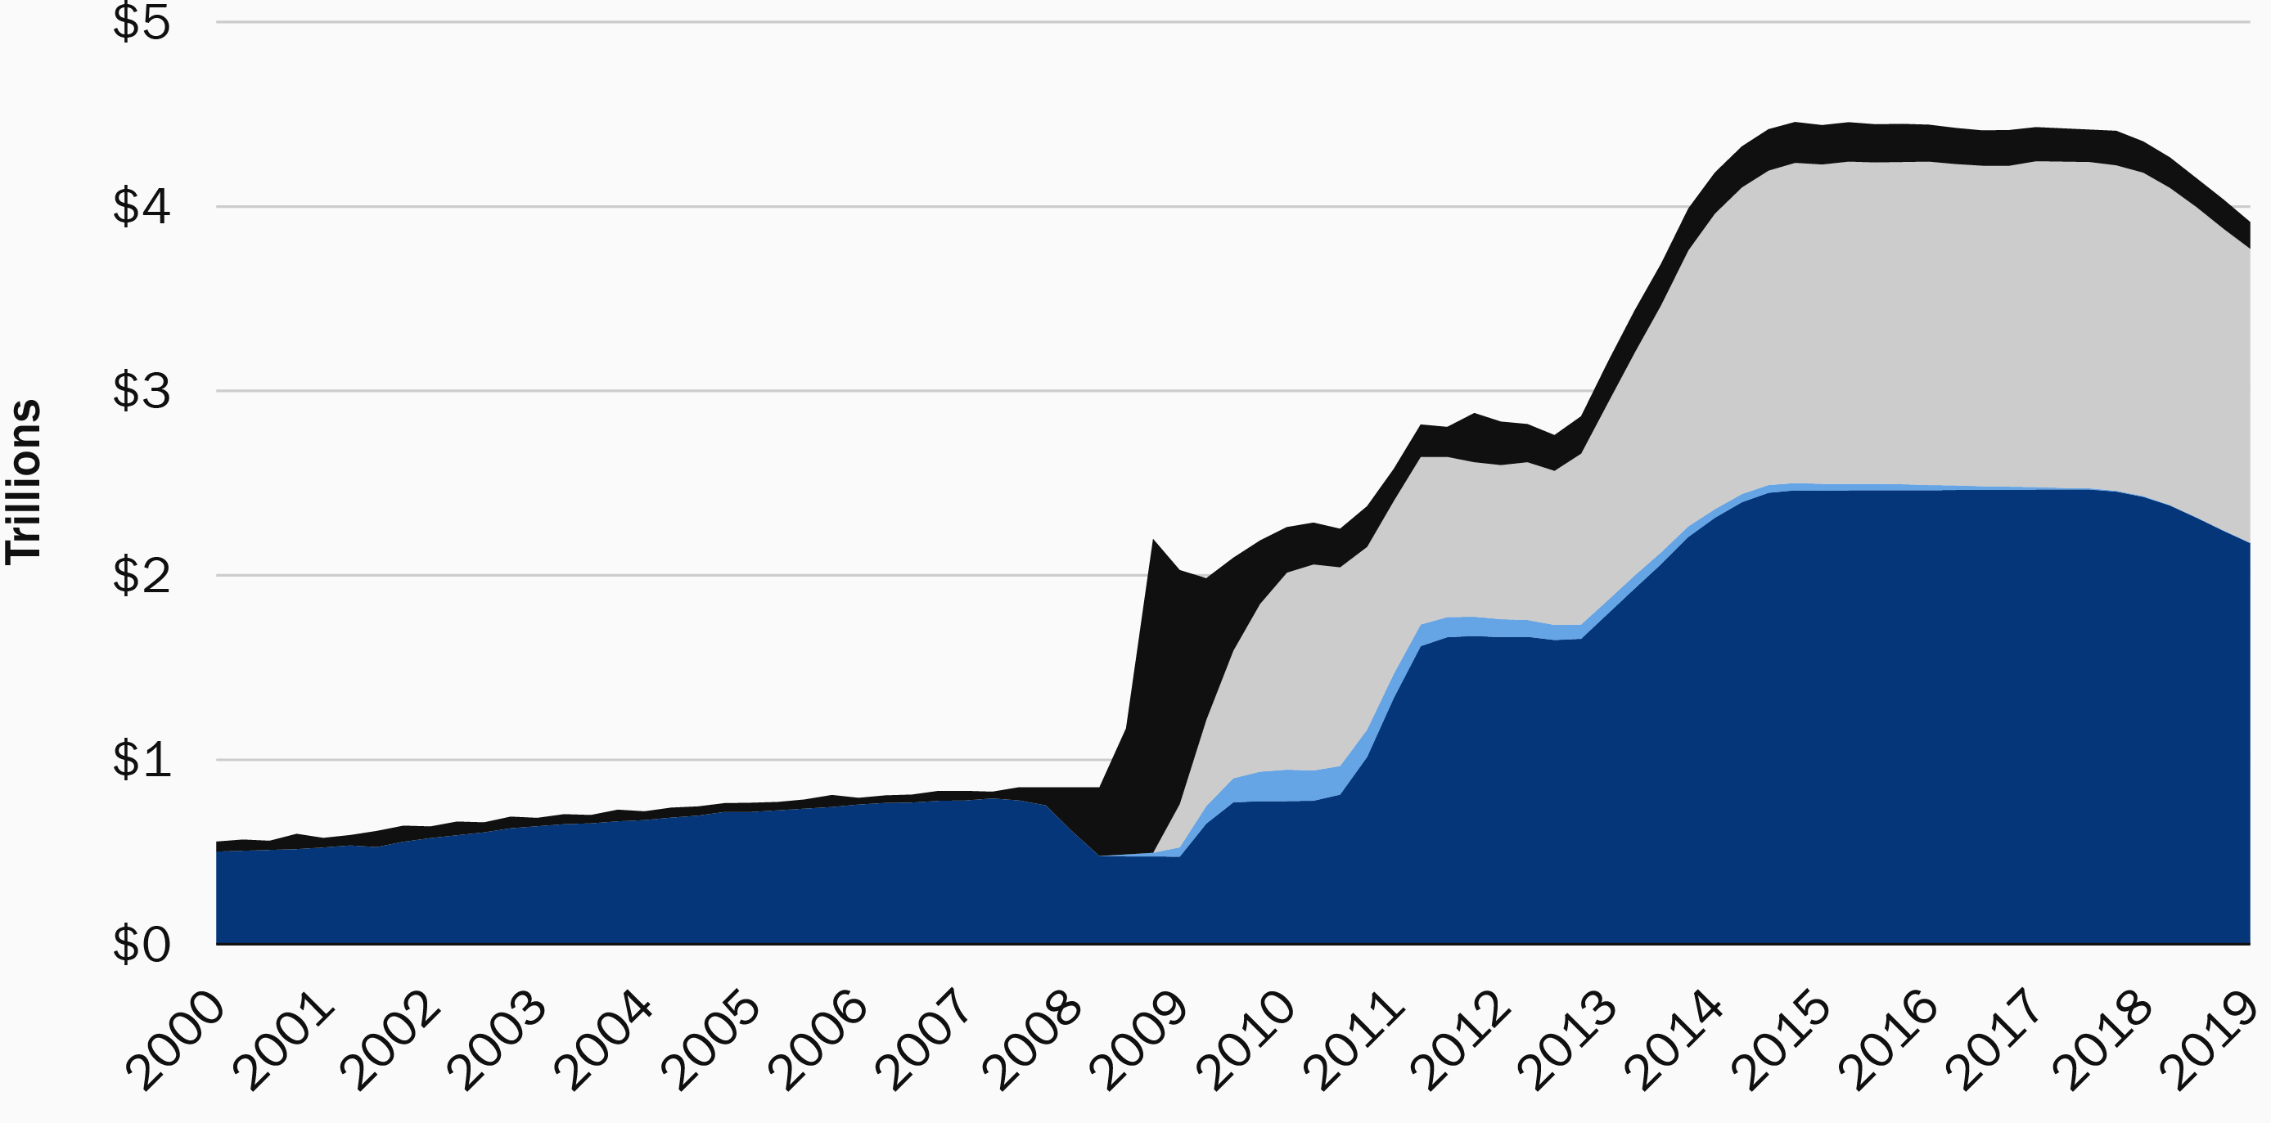
NTE 1010 – Introduction to Finance for Engineers
Stock Markets
Quantitative Easing
Quantitative easing (QE) is a monetary policy, implemented by the Central Bank,
primarily to energize the economy.
The Central Bank will create money to buy government securities from the market
in order to lower interest rates and increase the money supply.
These economic conditions will then trigger financial institutions
to promote increased lending and to make money supply more liquid.
FED’s Balance Sheet size
QE2
QE3
QE1

Slide 8
NTE 1010 – Introduction to Finance for Engineers
Financial Crises
Basics of the World Financial Structure
Stocks are not the most important source of external financing for businesses.
Issuing marketable debt and equity securities is not the primary way
in which businesses finance their operations either.
(Bank Loans, Non-Bank Loans, Bonds, Stocks)
Indirect finance, which involves the activities of financial intermediaries,
is many times more important than direct finance,
in which businesses raise funds directly from lenders in financial markets.
Financial intermediaries, particularly banks, are the most important source of external funds
used to finance businesses.
The financial system is among the most heavily regulated sectors of the economy.
Only large, well-established corporations
have easy access to securities markets to finance their activities.
Collateral is a prevalent feature of debt contracts for both households and businesses.
Collateral is a property that is pledged to a lender to guarantee payment
in the event that the borrower is unable to make deby payments.
Debt instruments typically are extremely complicated legal documents
that place substantial restrictions on the behavior of the borrower.

Slide 9
NTE 1010 – Introduction to Finance for Engineers
Financial Crises
Dynamics in Advanced Economies
Stage One:
Initiation of Financial Crisis
a - Mismanagement of
Financial Innovation
introduction of new types of loans or other financial products
and/or Liberalization
elimination of restrictions on financial markets and institutions:
which can promt financial institutions to go on a lending spree, called a credit boom
even with proper management
credit booms eventually outstrip the ability of institutions – and government regulators –
to screen and monitor credit risks,
leading to overly risky lending
eventually, losses on loans begin to mount,
and the value of the loans (on the asset side of the balance sheet) falls relative to liabilities,
thereby driving down the net worth (capital) of banks and other financial institutions
with less capital, these financial institutions cut back on their lending to borrower-spenders

Slide 10
NTE 1010 – Introduction to Finance for Engineers
Financial Crises
Dynamics in Advanced Economies
Stage One:
Initiation of Financial Crisis
b – Asset-Price Boom and Bust
Prices of assets such as equity shares and real estate
can be driven by investor psychology well above thier fundemental economic values,
that is, their values based on realistic expectations of the assets’ future income streams.
The rise of asset prices above their fundemental economic values is an asset-price bubble.
Asset-price bubbles are often also driven by credit booms,
in which the large increase in credit is used to fund purchases of assets,
thereby driving up their price.
c – Increase in Uncertainty
With information hard to come by in a period of high uncertainty,
financial frictions increase, reducing lending and economic activity.

Slide 11
NTE 1010 – Introduction to Finance for Engineers
Financial Crises
Dynamics in Advanced Economies
Stage One:
Initiation of Financial Crisis
Stage Two:
Banking Crisis
Deteriorating balance sheets and tougher business conditions lead some financial institutions into insolvency, when net worth becomes negative.
Unable to pay depositors or other creditors, some banks go out of business.
If severe enough, these factors can lead to a bank panic, in which multiple banks fail simultaneously.
Eventually, public and private authorities shut down insolvent firms and sell them off or liquidate them.
Uncertainty in financial markets declines, the stock market recovers, and balance sheets improve.
Financial frictions diminish and the financial crisis subsides.
With the financial markets able to operate well again,
the stage is set for an economic recovery.

Slide 12
NTE 1010 – Introduction to Finance for Engineers
Financial Crises
Dynamics in Advanced Economies
Stage One: Initiation of Financial Crisis
Stage Two: Banking Crisis
Stage Three:
Debt Deflation
If, however, the economic downturn leads to a sharp decline in the price level,
the recovery process can be short-circuited.
In economies with moderate inflation, which characterizes most advanced economies, many debt contracts with fixed interest rates are typically of fairly long maturity, ten years or more.
Because debt payments are contractually fixed in nominal terms,
an unanticipated decline in the price level raises the value of borrowing firms’ liabilities in real terms (increases the burden of debt) but does not raise the value of borrowing firms’ assets.
The borrowing firms’ net worth in real terms
(the difference between asets and liabilities in real terms) thus declines.
And, this causes borrowing / lending apetite to decline,
thus the economy cools down.

Slide 13
NTE 1010 – Introduction to Finance for Engineers
Financial Crises
Causes of 2007-2009 Financial Crisis
a – Financial innovations in the mortgage markets
Advances in computer technology and new statistical techniques, known as data mining, led to enhanced, quantitative evaluation of the credit risk for a new class of risky residential mortgages.
By lowering transaction costs, computer technology enabled the bundling together of smaller loans (like mortgages) into standard debt securities, a process known as securitization.
These factors made it possible for banks to offer subprime mortgages
to borrowers with less-than-stellar credit records.
b – Agency problems in the mortagage markets
The mortgage brokers that originated the loans often did not make a strong effort
to evaluate whether the borrower could pay off the loan,
since they would quickly sell (distribute) the loans to investors in the form of mortgage-backed securities.
Once the mortgage broker earns his fee, why should he care if the borrower makes good on his payment?
Risk-loving investors lined up to obtain loans to acquire houses
that would be very profitable if housing prices went up,
knowing they could ″walk away″ if housing prices went down.
c – Asymmetric information and Credit-Rating Agencies
The rating agencies advised clients on how to structure complex financial instruments,
at the same time they were rating these identical products.
They were thus subject to conflicts of interest because the large fees they earned from
advising clients on how to structure products they were rating meant that
they did not have sufficient incentives to make sure that their rating were accurate.

Slide 14
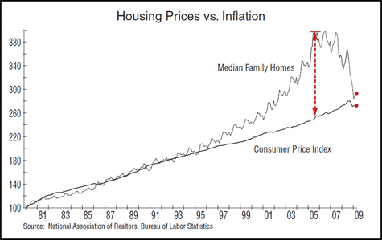
NTE 1010 – Introduction to Finance for Engineers
Financial Crises
Effects of 2007-2009 Financial Crisis
Aided by liquidity from huge cash inflows into the United States from countries like China and India,
and low interest rates on residential mortgages,
the subprime mortgage market took off after the recession ended in 2001.
It was lauded by economists and politians alike because it led to a ″democratization of credit″
and helped raise US homeownership rates to the highest levels in history.
Housing priced
boomed
from 2002 to 2006,
fueling the market for
subprime mortgages
and forming
an asset-price buble.
Housing prices
began declining
in 2006,
falling by more than
30% subsequently,
which led to defaults
by subprime
mortgage holders.

Slide 15
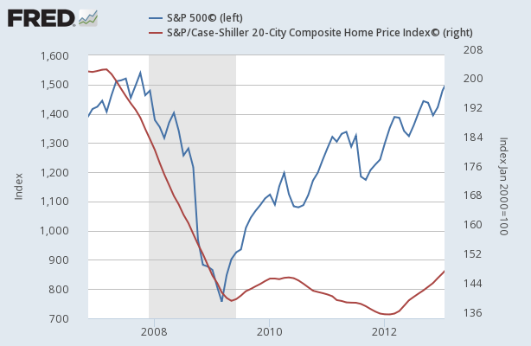
NTE 1010 – Introduction to Finance for Engineers
Financial Crises
Effects of 2007-2009 Financial Crisis
The sharp decline in the value of mortgages and other financial assets triggered a run
on the shadow banking system, composed of hedge funds, investment banks, and other nondepository financial firms, which are not as tightly regulated as banks.
To raise funds, financial institutions had to engage in fire sales and sell off their assets very rapidly.
Because selling assets quickly requires lowering their price,
the fire sales led to a further decline in financial institutions’ asset values.

Slide 16
NTE 1010 – Introduction to Finance for Engineers
Financial Crises
Dynamics in Emerging Market Economies
Stage One:
Initiation of Financial Crisis
a - Mismanagement of Financial Liberalization
and/or Globalization
opening up economies to flows of capital and financial firms from other countries
b – Asset-Price Boom and Bust
c – Increase in Uncertainty
d – Severe fiscal imbalances
When governments in emerging market countries face large fiscal imbalances and cannot finance their debt, they often cajole or force banks to purchase government debt.
If investors lose confidence in the ability of the government to repay its debt,
the banking system weakens.
Also, with less free resources, banks will lend less.
e – Increase in interest rates
When interest rate rise, high-risk firms are most willing to pay the high interest rates,
so the asset quality of banks deteriorates.

Slide 17
NTE 1010 – Introduction to Finance for Engineers
Financial Crises
Dynamics in Emerging Market Economies
Stage One: Initiation of Financial Crisis
Stage Two: Currency Crisis
As the effects of any or all of the factors mentioned previously build on each other,
participants in the foreign exchange market sense an opportunity:
they can make huge profits if they bet on a depreciation of the currency.
Speculators engage in massive sales of the currency.
As the currency sales flood the market, supply far outstrips demand,
the value of the currency collapses, and a currency crisis ensues.
High interest rates abroad, increases in uncertainty, and falling asset prices all play a role.
Stage Three: Full-Fledged Financial Crisis
In contrats to most advanced economies that typically denominate debt in domestic currency,
emerging market economies denominate many debt contracts in foreign currency
leading to what is referred to as currency mismatch.
An unanticipated depreciation or devaluation of the domestic currency in emerging market countries
increases the debt burden of domestic firms in terms of domestic currency.
The collapse of a currency also can lead to higher inflation as prices of imported goods go up.

